Slide 1
Objects & Strings: Operators & Methods.
Week 3 | Lecture 1 (3.1.1)
While waiting for class to start:
Download and open the Jupyter Notebook (.ipynb) for Lecture 3.1.1
You may also use this lecture’s JupyterHub link instead (although opening it locally is encouraged).
Upcoming:
Reflection 3 released Friday @ 11 AM
Lab 3 deadline this Friday @ 11 PM
TUT (Tutorial) this week is ONLINE
PRA (Lab) on Friday @ 2PM this week (ONLINE)

Slide 2
Today’s Content
Lecture 3.1.1
Objects & Strings: Operators and Methods
Lecture 3.1.2
Strings: Conversions, Indexing, Slicing, and Immutability

Slide 3


Let’s revisit our Turtle friend…
import turtle
LeBron = turtle.Turtle()
LeBron.right(90)
LeBron.forward(200)
LeBron.left(90)
LeBron.forward(100)
turtle.done()

Slide 4
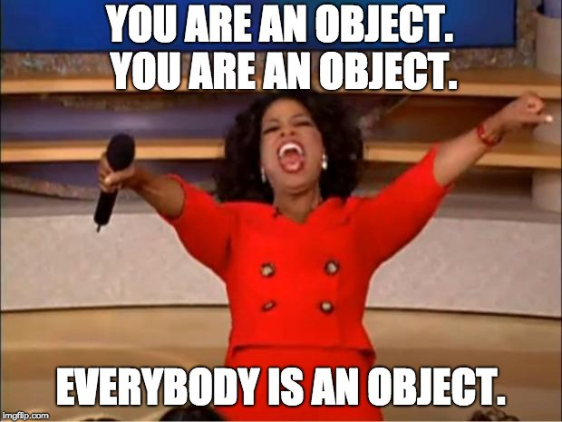
Everything is an Object!
Python keeps track of every value, variable, function, etc. as an object
There is a function that you can call to confirm:
>>> isinstance(4, int)
True
>>> isinstance(“Hello”, str)
True
>>> isinstance(4, object)
True
>>> isinstance(‘Hello”, object)
True

Slide 5
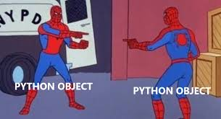
Everything is an Object!
Remember the id (or identity) function
It returns each object’s location in memory
>>> id(4)
4482837280
>>> id(int)
4482678880
>>> id(‘a’)
140432546199344
>>> id(str)
4482716800

Slide 6
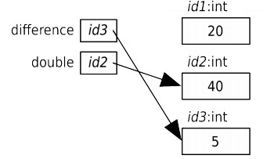
Memory Visualization Example
>>> difference = 20
>>> double = 2 * difference
>>> double
40
>>> difference = 5
>>> double
40
Notes:
Let’s go through an example of variable assignment and how this looks in memory. Understanding how memory works in your computer can help clear up how the computer thinks and how it’s interpreting what you’re saying.
So, looking at the first line, what is the variable? What is the expression?

Slide 7
Objects have Methods
Each Python object has certain functions that can only be applied to that object
These are called methods
The general form for calling a method is:
Since methods are applied to objects, we need to provide the object name with the “dot operator” (“.”) before the method name. Look familiar?
object_name.method_name(arguments)

Slide 8
Let’s revisit our friend LeBron…
import turtle
LeBron = turtle.Turtle()
LeBron.right(90)
LeBron.forward(200)
LeBron.left(90)
LeBron.forward(100)
turtle.done()

Slide 9
Let’s revisit our friend LeBron…
import turtle
LeBron = turtle.Turtle()
LeBron.begin_fill()
LeBron.color(‘red’)
LeBron.right(90)
LeBron.forward(200)
LeBron.left(90)
LeBron.forward(100)
LeBron.end_fill()
turtle.done()

Slide 10
Let’s Code!
Let’s take a look at how this works in Python!
id function to get object’s memory address
isinstance function to determine object type
Turtle LeBron drawing shapes!
Open your notebook
Click Link:
1. Objects & Methods

Slide 11
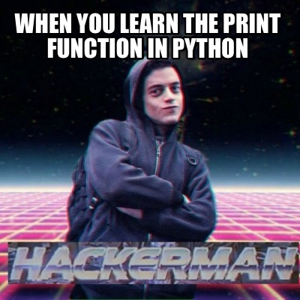
RECAP: Input and Output
Python has a built-in Input/Output functions:
print – for displaying text to the user
input – for reading text from the user
These functions require a good understanding of strings and string formatting

Slide 12
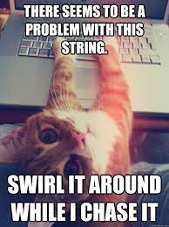
Working with Strings
The string (str) type was briefly introduced in previous weeks
Let’s take our string knowledge to the next level!
escape sequences
str operations
type conversion
str indexing and slicing
str methods

Slide 13
Escape Sequences
Special character called an escape character: \ (backslash)
When used in a string, the character following the escape character is treated differently from normal.
Escape sequence | Name | Example | Output
\n | newline (ASCII - line feed) | “How\nare\nyou?” | How are you?
\t | tab (ASCII - horizontal tab) | ‘3\t4\t5’ | 3 4 5
\\ | backslash (\) | ‘\\’ | \
\’ | single quote (‘) | ‘don\’t’ | don’t
\” | double quote (”) | “He says, \”Hi\”.” | He says, “hi”.

Slide 14
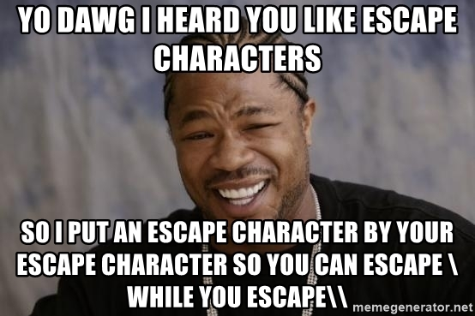
Let’s Code!
Let’s take a look at how this works in Python!
Working with the print function
Escape sequences!
New lines
Tabs
Quotes
Open your notebook
Click Link:
2. Escape Sequences

Slide 15
String Operators
There are certain mathematical operators that can be applied on strings
The * and + obey standard precedence rules (i.e. * before +)
All other mathematical operators and operands result in a TypeError
Expression | Name | Example | Output
str1 + str2 | concatenate str1 and str1 | print('ab' + 'c') | abc
str1 * int1 | concatenate int1 copies of str1 | print('a' * 5) | aaaaa
int1 * str1 | concatenate int1 copies of str1 | print(4 * 'bc') | bcbcbcbc

Slide 16
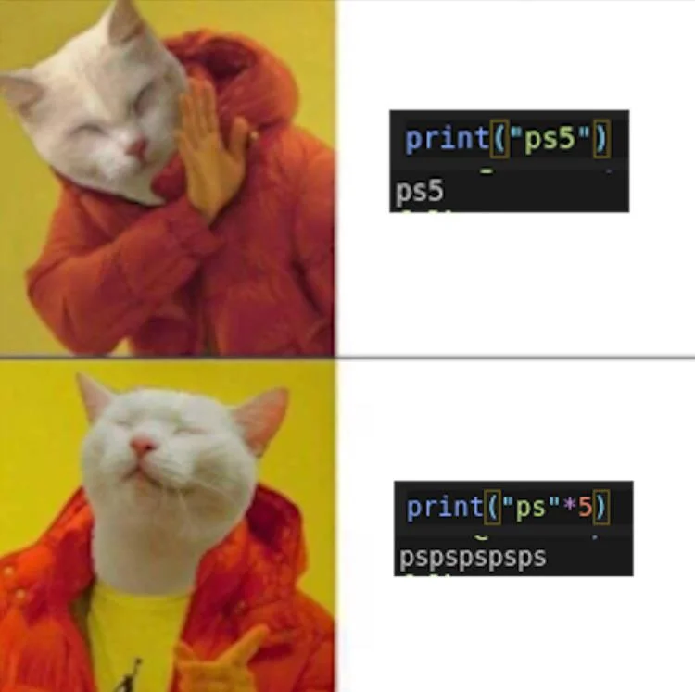
Let’s Code!
Let’s take a look at how this works in Python!
Concatenation
+ operator
* operator
Open your notebook
Click Link:
3. String Operators

Slide 17
Possible Stopping Point

Slide 18

Working with Strings
The string (str) type was briefly introduced in previous weeks
Let’s take our string knowledge to the next level!
escape sequences
str operations
type conversion
str indexing and slicing
str methods

Slide 19
Type Conversion
The built-in function str takes any value and returns a string representation of that value
Like our built-in functions int and float that can take a string and attempt to return a number representation of the string
>>> str(4) ‘4’
>>> str(4482678880) ‘4482678880’
>>> int('12345')
12345
>>> int(-99.9) -99
>>> float(‘-43.2’) -43.2
>>> float(’432’) 432.0

Slide 20
Let’s Code!
Let’s take a look at how this works in Python!
Type conversion
int/float to string
string to int/float
Open your notebook
Click Link:
4. Type Conversions

Slide 21
Breakout Coding Session!
Ask the user how many times they would like to see the string ”knock knock knock… Penny” repeated. Then, print it!
Can you customize the name?
Open Python (PyCharm or Jupyter)
Work with your table (or those around you) to solve this problem!

Slide 22
Consider this…
Ask the user how many times they would like to see the string ”knock knock knock… Penny” repeated, and print it!
Can you customize the name?
Hints for getting started:
Ask the user for a number of times (think: input function)
Remember input function returns a string…
Repeated string (think: concatenation, * operator might be useful)
Make the output readable (think: escape characters)

Slide 23
Objects & Strings: Operators & Methods.
Week 3 | Lecture 1 (3.1.1)

